Slide 1

GUEST LECTURER: DR. NAM HAI LE
DOES STOCK PRICE HAVE MEMORY?
INSIGHTS FROM CHAOS THEORY
Exploring Market Efficiency and Chaos in Financial Markets
21 March 2024

Slide 2
Understanding Complex Market Behaviors
Advanced Financial Analysis Techniques:
-- Hurst Exponents to assess market efficiency and memory
-- Statistical tests to evaluate the randomness and efficiency of market movements
Trading Strategies based on Hurst Exponents
-- Persistence (trend following)
-- Anti-persistence (mean-reversion)
Critical Thinking in Finance
WHAT WE'LL DISCUSS

Slide 3

Introduction to Efficient Market Hypothesis
EMH Defined: Financial markets are efficient and reflect all available information.
Suggests that price movements are essentially random and follow a "random walk," without predictable patterns or memory.
Implication: Impossible to "beat the market" consistently on a risk-adjusted basis.
Criticisms:
Market anomalies. Flash Crash
Psychological factor, herding behaviour affects market movement.
Insider trading
Fama, E.F. (1970). "Efficient Capital Markets: A Review of Theory and Empirical Work." The Journal of Finance, 25(2), 383-417.
Notes:
Criticisms:
Despite its widespread acceptance, EMH has faced criticism and skepticism from various quarters. One criticism is the presence of market anomalies, such as the Flash Crash of 2010, where market prices experienced a rapid and severe decline followed by a quick recovery, challenging the idea of market efficiency.
Additionally, human psychology and behavior, such as herd mentality among investors, can influence market movements in ways that don't align with the assumptions of EMH. This suggests that emotions and irrational behavior can play a significant role in market dynamics.
Furthermore, instances of illegal insider trading, where individuals trade on non-public information, raise questions about the efficiency of markets in incorporating all available information into prices. If insiders can profit by trading on privileged information, it suggests that markets may not be as efficient as the theory suggests.

Slide 4

MARKET INEFFICIENCIES AND ANOMALIES
Example: "Consider the 'January Effect,' where stocks, especially small caps, tend to outperform at the beginning of the year. This suggests that investors can predict and potentially exploit this pattern, challenging the notion of market efficiency."
MARKET INEFFICIENCIES: NOT ALL MARKETS ARE PERFECT; SOMETIMES, PRICES DON'T REFLECT ALL AVAILABLE INFORMATION.
Behavioral Factors: Investor behavior, like overreaction or herd mentality, can create predictable price movements.
Notes:
Even though EMH suggests markets are efficient, real life shows us otherwise. Sometimes, stock prices don't immediately reflect new information."
Explaining Anomalies with Examples:
Momentum: "Think of it like a snowball rolling downhill, getting bigger. If a stock has been going up, it often continues to rise for a while. This is momentum."
Mean Reversion: "After extreme changes, stocks often move back towards their average price. It's like stretching a rubber band and letting it snap back."
Calendar Effects: "Some patterns follow the calendar. For example, the 'January Effect' is when stocks, especially smaller companies, see higher returns at the start of the year."
Behavioral Factors: "Why do these anomalies happen? Often, it's because of how we, as investors, behave. Overreacting to news or following others can push prices away from their 'true' value."
Wrap Up: "These inefficiencies and anomalies show that markets aren't always as efficient as we might think. They offer opportunities for investors to potentially 'beat' the market, challenging the core of EMH."
4

Slide 5
Common Anomalies
MOMENTUM
MEAN REVERSION
Stocks that go up/down tend to keep going up/down in the short term.
Stocks with extreme movements tend to return to their average price.
CALENDAR EFFECTS
Stock patterns based on time, like higher returns in January.

Slide 6

Market Inefficiencies and Anomalies
Photo generated by AI

Slide 7

Complex Systems: Systems with many interconnected parts that behave unpredictably: The whole is more than the sum of its parts
=> Nonlinear Dynamic Relationships
Sensitivity to Initial Conditions: Small changes can lead to vastly different outcomes, known as the butterfly effect.
Chaos Theory: A subfield in math-physics, explores how subtle variations in a dynamic system's initial conditions can lead to significant and unpredictable changes in the system's future state.
Emergent Behaviour:
Examples: weather, pendulum, brain/neural networks, Market,...
Complex Systems, Chaos Theory
Notes:
Definition:
Complex systems consist of many interconnected parts that interact in unpredictable ways. They exhibit emergent properties where the whole system behaves differently from the sum of its individual parts.
Nonlinear Dynamic Relationships:
In complex systems, relationships between variables are often nonlinear, meaning small changes can lead to disproportionate outcomes. This makes predicting the system's behavior challenging.
Sensitivity to Initial Conditions:
Complex systems are highly sensitive to initial conditions, a concept popularized by the butterfly effect. Tiny variations in starting conditions can result in vastly different outcomes over time.
Chaos Theory:
Chaos theory, a branch of mathematics and physics, studies how small differences in initial conditions can lead to significant and unpredictable changes in a system's future behavior. It emphasizes the inherent unpredictability of complex systems.
Emergent Behavior:
Emergent behavior refers to phenomena that arise from the interactions of individual components in a complex system. These behaviors cannot be predicted by studying the individual parts alone but emerge from the collective interactions within the system.
Examples:
Examples of complex systems include weather patterns, the movement of a pendulum, the functioning of brain or neural networks, and financial markets. These systems exhibit emergent properties, nonlinear dynamics, and sensitivity to initial conditions, illustrating the principles of complexity theory.

Slide 8

MARKET AS A COMPLEX ADAPTIVE SYSTEM
Adaptive Agents: individual traders, institutions, and algorithms,... responding to new information and adjusting their strategies accordingly.
Feedback Loops
Emergent Behaviour: not predictable from individual elements alone
Adaptation and Evolution: evolve over time, with strategies, regulations, and technologies continuously adapting, leading to an ever-changing landscape.
Notes:
Adaptive Agents:
Adaptive agents are individual traders, institutions, algorithms, and other entities in a system that respond to new information by adjusting their strategies. They play a crucial role in shaping the behavior of the system.
Feedback Loops:
Feedback loops are mechanisms where the outputs of a system are fed back into it as inputs, influencing future behavior. These loops can help increase or decrease certain behaviors within the system, contributing to its overall dynamics.
Emergent Behavior:
Emergent behavior refers to outcomes that arise from the interactions of adaptive agents in the system. These behaviors cannot be predicted solely by studying the individual agents but emerge from their collective actions and feedback loops.
Adaptation and Evolution:
Systems with adaptive agents continuously evolve over time. Strategies, regulations, and technologies adapt and change, leading to an ever-evolving landscape. This ongoing adaptation shapes the dynamics of the system and its emergent behavior.

Slide 9


Early Pioneers
Norman Packard
Doyne Farmer
Renowned physicists who explored the boundaries of chaos theory and complex systems at Los Alamos and Santa Fe
Founded the Prediction Company with a vision to decode market behavior through advanced mathematical models.
Not just for academic fulfillment but to gain financial independence, aiming to become millionaires and fund their research without the constraints of traditional grant systems.
achieved an impressive track record, consistently outperforming the market and managing over $1 billion in assets before being acquired by UBS in 2006.
Notes:
Ther aim wasn't solely academic; they sought financial independence, envisioning themselves as millionaires who could fund their research independently, liberated from traditional grant systems.
Despite their academic roots, the Prediction Company achieved remarkable success in the financial world.
They consistently outperformed the market, managing assets exceeding $1 billion, showcasing the practical application of chaos theory in finance.
Their accomplishments didn't go unnoticed, leading to their acquisition by UBS in 2006.
Their journey from theoretical physicists to successful financiers highlights the real-world impact of their work and the transformative potential of chaos theory in understanding and navigating financial markets.

Slide 10

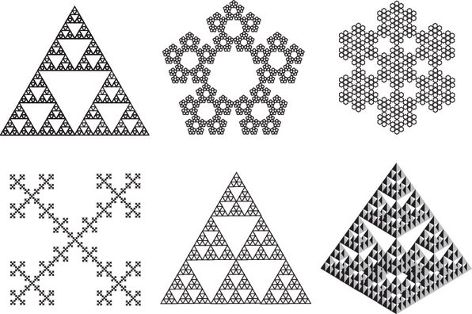

Mandelbrot Set
‹#›
Notes:
Fractals are structures that show self-similarity across different scales, meaning they look similar up close as they do from a distance. They can be deterministic (where the pattern is precisely the same at every scale) or statistical (where the pattern is statistically similar at different scales). Fractals are more than just mathematical curiosities; they are found extensively in nature, in forms such as snowflakes, mountain ranges, lightning bolts, and coastlines.

Slide 11
FRACTAL MARKET HYPOTHESIS
Proposed by Mandelbrot -- a pioneer in fractal and chaos study
Markets exhibit fractal characteristics, meaning market movements are self-similar across different time scales.
This contradicts the linear models traditionally used in financial analysis
(e.g. Capital Asset Pricing Model (CAPM) )
Notes:
Fractal Characteristics:
Markets display fractal traits, meaning patterns repeat at various time scales, challenging linear models like the CAPM.
Self-Similarity Across Time:
Whether observed over minutes, hours, or years, market movements exhibit consistent patterns, defying traditional linear assumptions.
Contradiction with Linear Models:
Linear models, such as the CAPM, fail to account for fractal nature, leading to inaccuracies in financial analysis and forecasting.
Implications for Analysis:
Recognizing market fractality prompts a need for updated financial models to better capture complex market dynamics and improve forecasting accuracy.

Slide 12
C﻿hallenge to EMH
FMH implies that understanding the fractal structure of markets could lead to better predictions of market movements, even if not with perfect accuracy.
Fr﻿actal Dimension: A statistical measure that quantifies the complexity of fractal patterns by describing how detail in a pattern changes with the scale at which it is measured.
Traders may use fractal-based tools like the Mandelbrot Set or Elliott Wave Theory to identify r﻿epeating patterns and potential trend reversals.
Market﻿ analysis can’t be confined to fixed timeframes or traditional geometric shapes.

Slide 13
HURST EXPONENT: A KEY TO UNDERSTANDING MARKET MEMORY
A statistical measure used to identify the nature of a time series: detecting trends, mean reversion, or random walk behavior.
Values range from 0 to 1:
+ H<0.5 indicates mean reversion,
+ H=0.5 suggests a random walk,
+ H>0.5 points to a persistent trend.

Slide 14

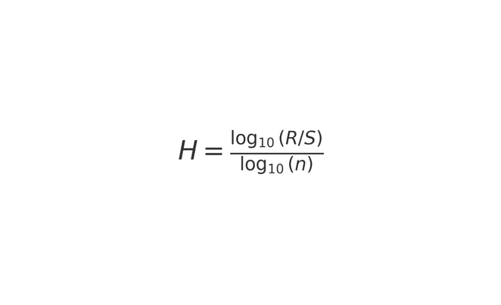
H.E. Hurst (1951): Originated the concept while analyzing the Nile River's flooding patterns to optimize dam storage capacities.
Mandelbrot and Wallis (1969): Extended Hurst's work, establishing its relevance to fractals and financial markets, illustrating that market prices exhibit memory and long-term dependencies.
Formula for Hurst Exponent:
Where R/S is the rescaled range and n is the length of the time series.

Slide 15
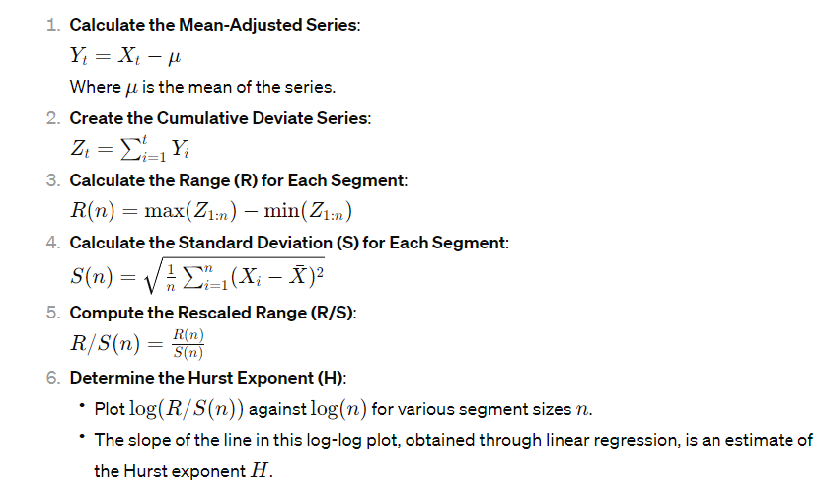
Notes:
11

Slide 16
IMPLICATIONS IN FINANCIAL MARKETS
Demonstrates that financial markets are not purely random and that past price changes can influence future price behavior.
Provides insights into the market's tendency towards mean reversion or trending, aiding in the development of trading strategies.
Applications for Traders: Traders can use the Hurst Exponent to assess the market's phase and adjust their strategies for trend following or mean-reversion.

Slide 17
Predictability & Hurst Exponents:
Examine the link between Hurst exponents and market predictability using LSTM models.
Fractal Market Hypothesis Today:
Assess FMH's relevance amidst high-frequency trading and AI's influence on market volatility.
Real-Time Application & Market Impact:
Debate the practical use of the Hurst exponent in trading systems and its effects on market dynamics.
Open Questions:
Is the Hurst exponent more effective for short-term trading or long-term strategies?
How might widespread adoption of Hurst exponent analysis influence market efficiency and stability?
FUTURE DIRECTIONS & Q&A

Slide 18
REFERENCES
Mandelbrot, B. B. (1983). The Fractal Geometry of Nature. WH Freeman and Company. - A seminal work introducing fractals.
Hurst, H.E. (1951). "Long-term storage capacity of reservoirs." Transactions of the American Society of Civil Engineers. - Introduces the Hurst exponent.
Fama, E.F. (1970). "Efficient Capital Markets: A Review of Theory and Empirical Work." The Journal of Finance, 25(2), 383-417. - Classic paper on EMH.
Peters, E.E. (1994). Fractal Market Analysis: Applying Chaos Theory to Investment and Economics. Wiley Finance. - Connects fractal geometry and financial markets.

